Slide 4
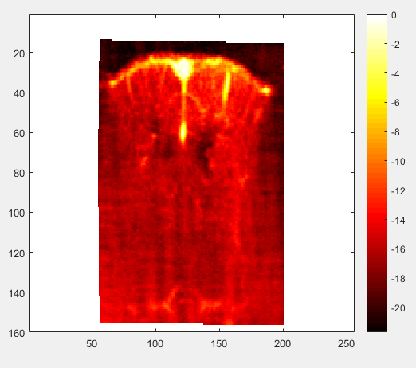

Slide 5
sBulk: 1-30/1000

Slide 6
sBulk: 1-20/1000

Slide 7
sBulk: 1-10/1000
sBulk: 1-5/1000

Slide 8
sBulk: 1-20/300
sBulk: 1-20/500

Slide 9
10*0.4 9*9
20*0.4 17*17

Slide 10
10*0.4 9*9 resolution: 20um/4 = 5um ; 5/30 = 1/6 um
20*0.4 17*17 resolution: 20um/8 = 2.5um 2.5/30 = 1/12um

Slide 11
15*0.2 13*13 resolution: 20um/6 = 3.33um 3.33/30 = 1/9 um

Slide 12
30*0.4 25*25 resolution: 20um/12 = 1.67um 1.67um/30 = 0.056 um
~25s

Slide 13
40*0.4 33*33 resolution: 20um/16 = 1.25um 1.25um/30 = 0.0417 um
~61s

Slide 14
50*0.4 41*41 resolution: 20um/20 = 1um 1um/30 = 0.033 um
~127s

Slide 15
Different ROI
7by7 87s 120/7 * 150/7 * 87s = 8.6h
3by3 15s 120/3 * 150/3 * 15s = 8.3h
5by5 30s 120/5 * 150/5 * 30s = 6h

Slide 16
40 * 0.2
80 * 0.1

Slide 17
20 * 0.4
40 * 0.1

Slide 18
Conclusion:
1. IQ data is venerable to blood and noise signal; Bulk data (SVD 1:20) is better
Different svd threshold
Different process time points
Different dx dz affect resolution and detection accuracy: >= 30by30 is appropriate for detection accuracy; 20 is appropriate for unexpected drifts (for 3by3 roi); ~ 30s
Different ROI: adjust
Different maximal detection shifts

Slide 20
#1
#2
#3
#4

Slide 21
#1
#2
#3
#1
#2
#3

Slide 22
#1
#2
#3
#1
#2
#3

Slide 23
#1
#2
#3
#1
#2
#3

